Slide 1


DESIGN AND ANALYSIS OF ALGORITHMS
Merge Sort: A Visual Demonstration of the Divide and Conquer Algorithm
Sorting by splitting, solving, and merging
Student Name: HARSHITA VINAYAK RETAR | PRN: 25070521252 | Division and Batch: 2 nd Year (E1) | Department: Computer Science | Field: Engineering

Slide 2
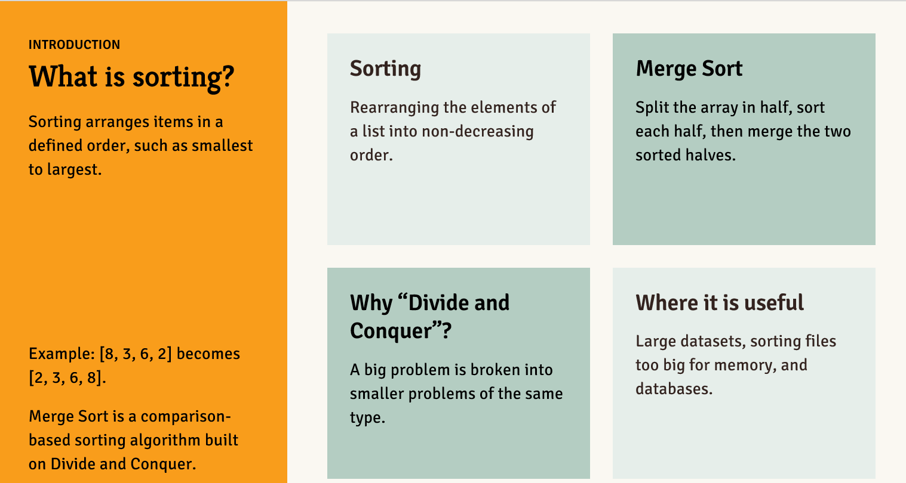
INTRODUCTION
What is sorting?
Sorting
Merge Sort
Rearranging the elements of a list into non-decreasing order.
Split the array in half, sort each half, then merge the two sorted halves.
Sorting arranges items in a defined order, such as smallest to largest.
Why “Divide and Conquer”?
Where it is useful
Large datasets, sorting files too big for memory, and databases.
Example: [8, 3, 6, 2] becomes [2, 3, 6, 8].
Merge Sort is a comparison-based sorting algorithm built on Divide and Conquer.
A big problem is broken into smaller problems of the same type.
2

Slide 3
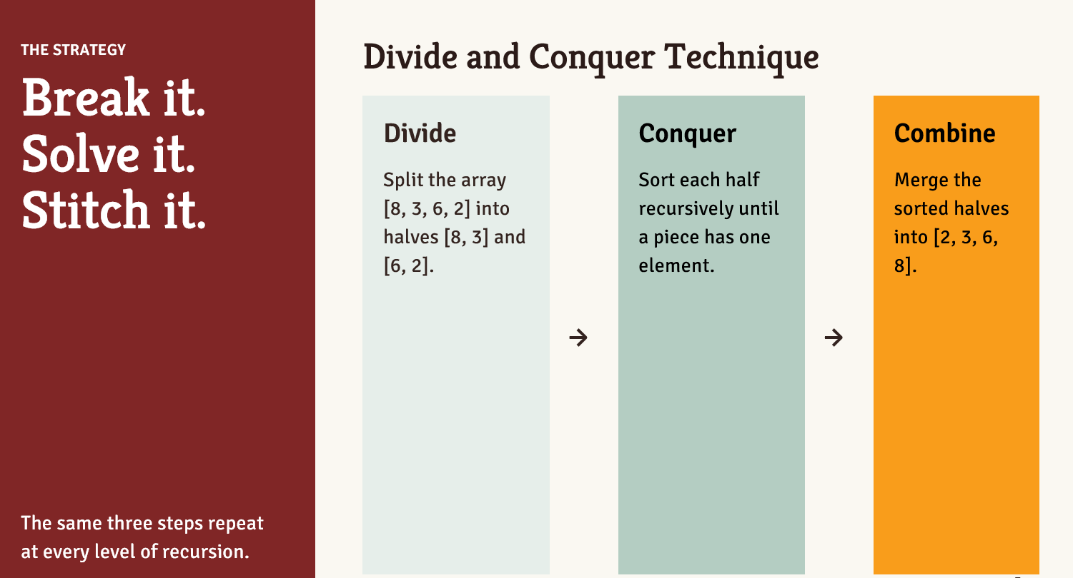
THE STRATEGY
Divide and Conquer Technique
Break it.
Solve it.
Stitch it.
Divide
Conquer
Combine
Split the array [8, 3, 6, 2] into halves [8, 3] and [6, 2].
Sort each half recursively until a piece has one element.
Merge the sorted halves into [2, 3, 6, 8].
→
→
The same three steps repeat at every level of recursion.
3

Slide 4
WORKED EXAMPLE
ORIGINAL ARRAY ↓
Sorting [8, 3, 6, 2]
[8, 3, 6, 2]
FIRST DIVISION ↓
[8, 3]
[6, 2]
SECOND DIVISION ↓
[8]
[3]
[6]
[2]
FIRST MERGING STAGE ↑
[3, 8]
[2, 6]
Each row is one stage of Merge Sort. Read from top to bottom.
FINAL MERGING STAGE ↑
[2, 3, 6, 8]
4

Slide 5
ALGORITHM
MergeSort and Merge
MergeSort(arr):
if length(arr) <= 1:
return arr
mid = floor(length(arr) / 2)
left = MergeSort(arr[0 : mid])
right = MergeSort(arr[mid : end])
return Merge(left, right)
Merge(left, right):
result = empty list
i = 0
j = 0
while i < length(left) and j < length(right):
if left[i] <= right[j]:
append left[i] to result
i = i + 1
else:
append right[j] to result
j = j + 1
append remaining elements of left and right to result
return result
Merge compares the front elements of two sorted subarrays and copies the smaller one into the result, until everything is merged.
Pseudocode is language-neutral.
5

Slide 6
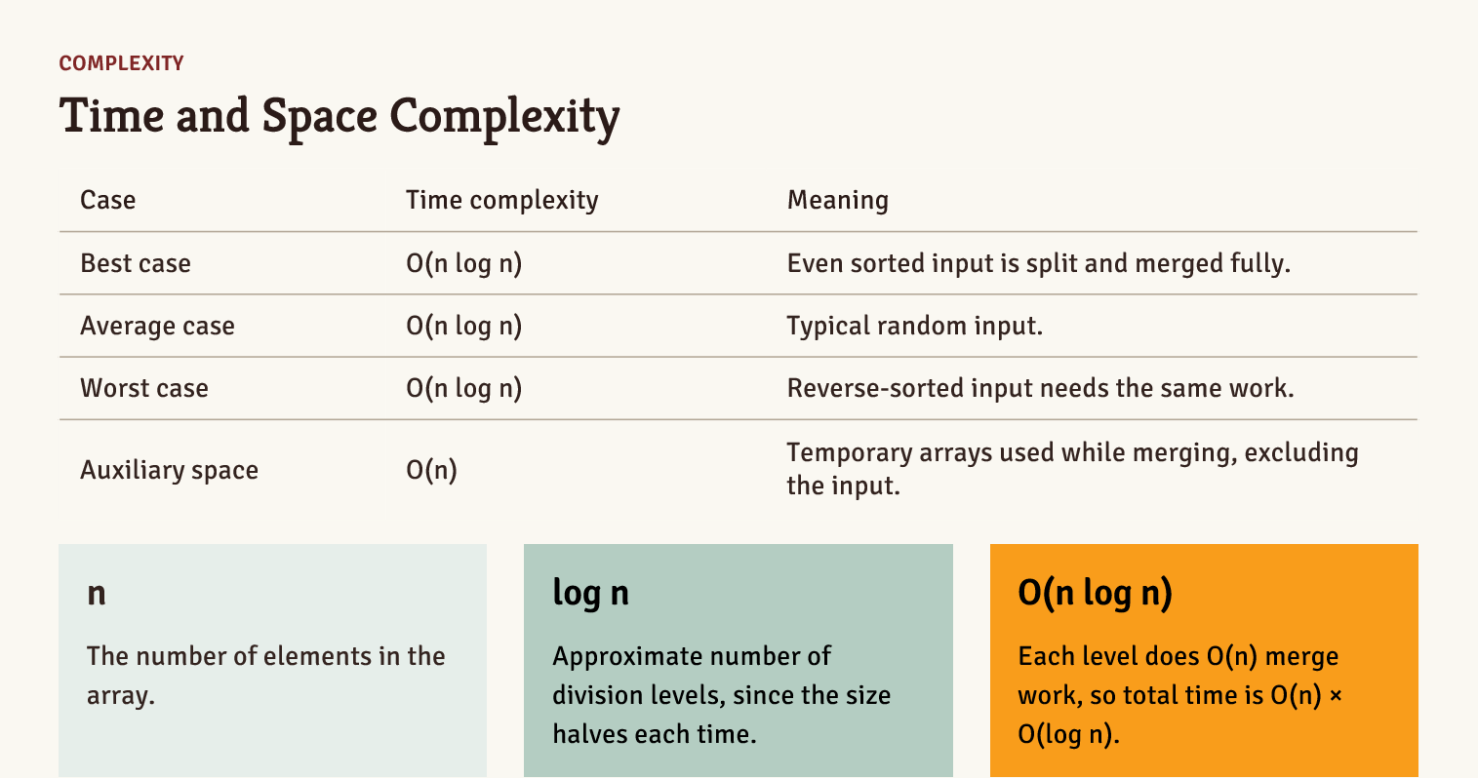
COMPLEXITY
Time and Space Complexity
Case | Time complexity | Meaning
Best case | O(n log n) | Even sorted input is split and merged fully.
Average case | O(n log n) | Typical random input.
Worst case | O(n log n) | Reverse-sorted input needs the same work.
Auxiliary space | O(n) | Temporary arrays used while merging, excluding the input.
n
log n
O(n log n)
The number of elements in the array.
Approximate number of division levels, since the size halves each time.
Each level does O(n) merge work, so total time is O(n) × O(log n).
6

Slide 7
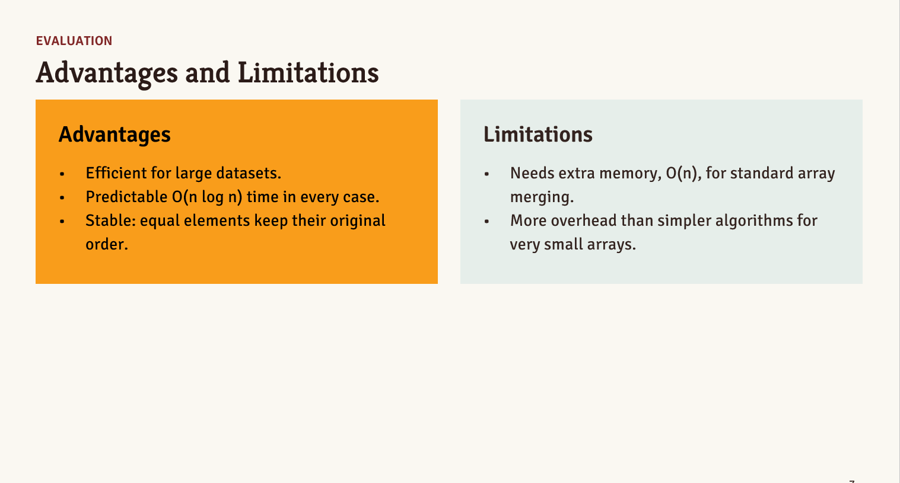
EVALUATION
Advantages and Limitations
Advantages
Limitations
Efficient for large datasets.
Predictable O(n log n) time in every case.
Stable: equal elements keep their original order.
Needs extra memory, O(n), for standard array merging.
More overhead than simpler algorithms for very small arrays.
7

Slide 8
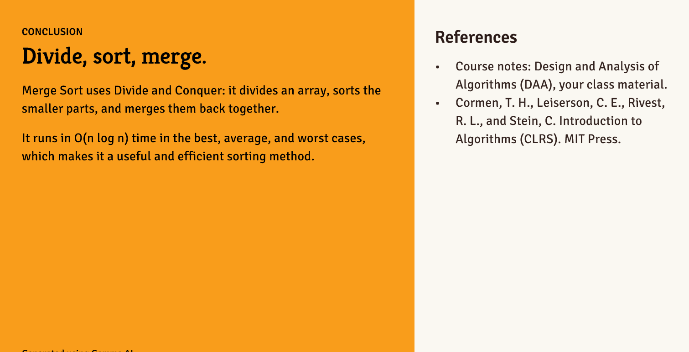
CONCLUSION
References
Divide, sort, merge.
Course notes: Design and Analysis of Algorithms (DAA), your class material.
Cormen, T. H., Leiserson, C. E., Rivest, R. L., and Stein, C. Introduction to Algorithms (CLRS). MIT Press.
Merge Sort uses Divide and Conquer: it divides an array, sorts the smaller parts, and merges them back together.
It runs in O(n log n) time in the best, average, and worst cases, which makes it a useful and efficient sorting method.
Generated using Gamma AI.
8

